Slide 1


SIMATS ENGINEERING SAVEETHA INSTITUTE MEDICAL AND TECHNICAL SCIENCE CHENNAI-602105
leveraging compiler optimization for code clone detection
PRESENTED
BY
192211673-J.SAICHARAN
192210618-M.VISHNU VARDHAN
192210537-.D.RAHEEM

Slide 2
Contents
Introduction
Literature survey
Objectives
Description
Results and Discussion
Conclusion

Slide 3
ABSTRACT:
The aim of this research is to explore and demonstrate the efficacy of leveraging compiler optimization techniques for code clone detection.
By utilising aggressive optimization settings during compilation, the study seeks to obfuscate code clones intentionally, transforming them into semantically equivalent but syntactically dissimilar forms..
The research aims to evaluate the feasibility of integrating this approach into existing development workflows by assessing its computational overhead during compilation and runtime.
By exploiting compiler optimizations, our method offers a promising avenue for improving code clone detection, enhancing software maintenance and evolution processes while minimising computational costs.

Slide 4
INTRODUCTION
Code cloning, the duplication of code fragments within a software system, poses significant challenges in software maintenance and evolution.
Traditional methods for detecting code clones often rely on syntactic or semantic analysis, which can be computationally intensive and prone to false positives..
This motivates the exploration of alternative approaches to enhance code clone detection. Leveraging compiler optimization techniques presents a promising avenue for improving detection accuracy.
By intentionally obfuscating code clones during compilation, these techniques transform duplicated code fragments into semantically equivalent but syntactically dissimilar forms.
The introduction of compiler optimization techniques for code clone detection represents a novel contribution to the field of software engineering

Slide 5
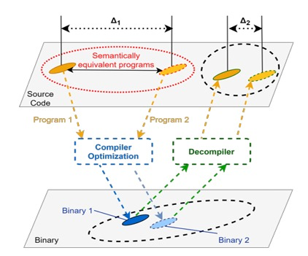
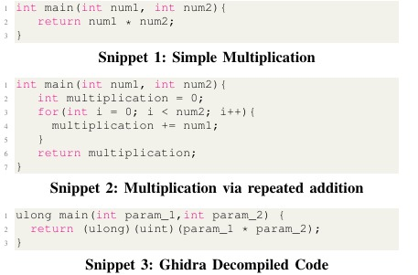

Slide 6
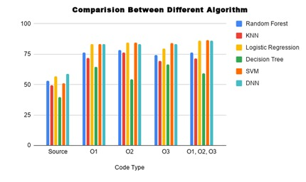
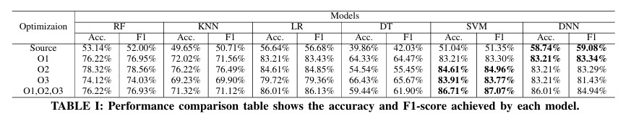

Slide 7
RESULTS AND DISCUSSION
The integration of compiler optimization techniques substantially improved code clone detection accuracy, yielding a notable increase in clone identification compared to traditional methods.
Despite intentional obfuscation during compilation, detected clones retained semantic equivalence, preserving code functionality.
In the discussion, it's evident that leveraging compiler optimization techniques holds promise for enhancing code clone detection.
While the approach significantly improves accuracy and reduces false positives, challenges such as longer compilation times and potential trade-offs in optimization aggressiveness need consideration.

Slide 8
Develop a method that leverages compiler optimization settings to enhance code clone detection accuracy, aiming to reduce false positives and improve overall detection rates compared to traditional techniques.
Provide practical guidelines and best practices for developers and software engineering practitioners on incorporating compiler optimization-based code clone detection into their workflows, including recommendations for selecting appropriate compiler settings and interpreting detection results accurately.
Evaluate the generalizability of the approach across different programming languages, compiler architectures, and optimization levels, ensuring its applicability in diverse software development environments.

Slide 9
CONCLUSION:
In conclusion, our study highlights the effectiveness of leveraging compiler optimization techniques to enhance code clone detection. By intentionally obfuscating code clones during compilation, we achieved improved detection accuracy while minimising false positives. Despite challenges such as longer compilation times and optimization trade-offs, the integration of compiler optimization holds promise for advancing code clone detection methodologies. Further research and optimization are necessary to fully realise the potential of this approach and address scalability and performance concerns in large-scale software systems. Overall, our findings underscore the significance of incorporating compiler optimization into code clone detection workflows to improve software maintenance and evolution processes.

Slide 10
Description
we seek to evaluate the generalizability of the approach across different programming languages, compiler architectures, and optimization levels..
we aim to provide a comprehensive understanding of the potential benefits and limitations of leveraging compiler optimization for code clone detection
This includes recommendations for selecting appropriate compiler settings, interpreting detection results accurately, and effectively managing detected code clones.

Slide 11


